Slide 1
LEAD SCORE CASE STUDY
PREPARED BY :
1. raj sethia
2. sagar sajnani
3. afrid mulla

Slide 2
Problem statement
An X Education need help to select the most promising leads, i.e. the leads that are most likely to convert into paying customers. The company requires us to build a model wherein you need to assign a lead score to each of the leads such that the customers with higher lead score have a higher conversion chance and the customers with lower lead score have a lower conversion chance. The CEO, in particular, has given a ballpark of the target lead conversion rate to be around 80%.
goals
There are quite a few goals for this case study.
To Build a logistic regression model to assign a lead score between 0 and 100 to each of the leads which can be used by the company to target potential leads.
There are some more problems presented by the company which your model should be able to adjust to if the company's requirement changes in the future so you will need to handle these as well.

Slide 3
Solution methodology
Loading & Cleaning the Data
Importing the Data
Cleaning the data frame
EDA
Univariate Analysis
Bivariate Analysis
Multivariate Analysis
Dummy Variables
Test-Train Split
Model Building
Creating Prediction
Model Evaluation
ROC Curve
Conclusion & Recommendation

Slide 4
1. Loading & Cleaning the data
1.1 Importing the data
Loading File “Lead.csv”
1.2 Inspect the dataframe
1.3 Cleaning the dataframe
Converting all string in Lowercase & Replacing N.A
Dropping the Unwanted Columns like 'Magazine','Receive More Updates About Our Courses','I agree to pay the amount through cheque','Get updates on DM Content','Update me on Supply Chain Content'
Checking the Null Values & Dropping the columns which has null value more
Then 35%.

Slide 5
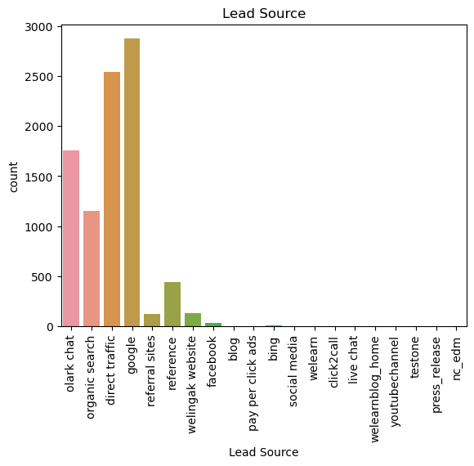
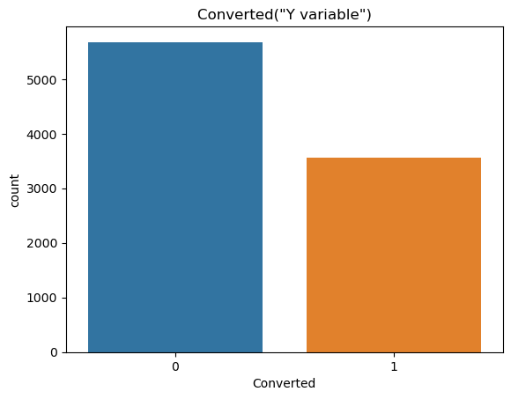
2. EDA
2. 1 Univariate Analysis
Lead Source
Count of “Converted” (Y variable)

Slide 6
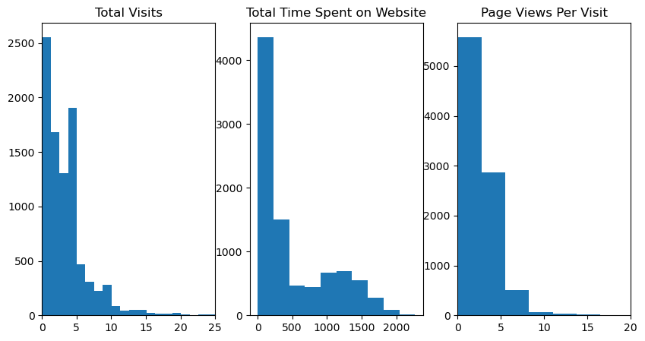
2.2 Bivariate Analysis
Total Visits , Total Time Spent on Website & Page View per visit

Slide 7
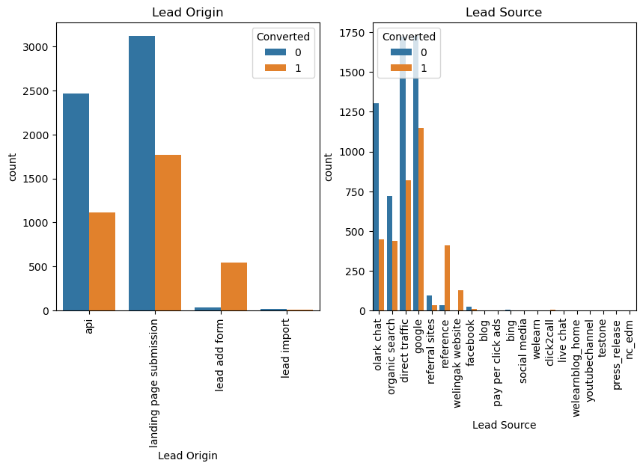
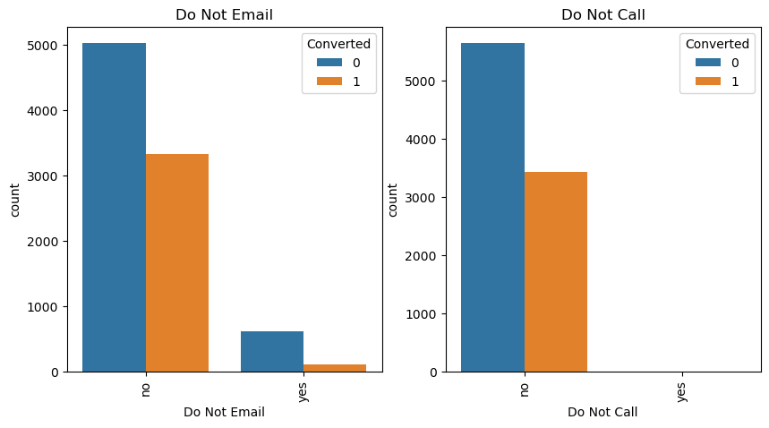
Lead Origin vs Count (Converted & Non-Converted)
Lead Source vs Count (Converted & Non-Converted)
Do Not Email vs Count (Converted & Non-Converted)
Do Not Call vs Count (Converted & Non-Converted)

Slide 8
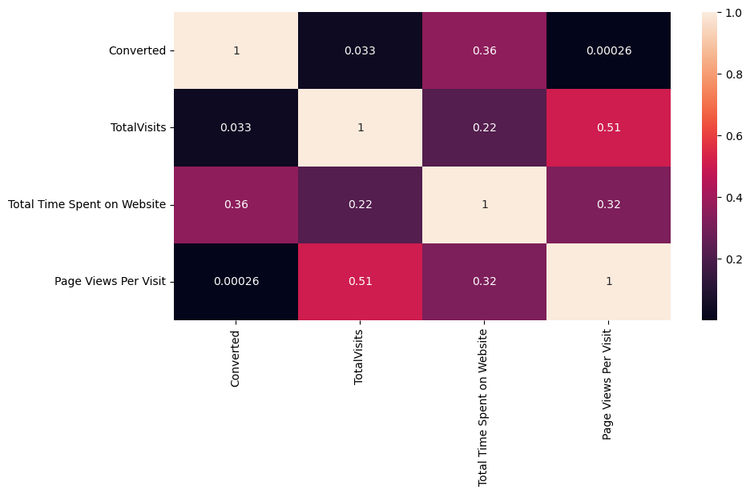
2. 3 Multivariate Analysis
Correlation between Variables

Slide 9
3. Dummy Variables
Creating Dummy Variables for 'Lead Origin', 'Specialization' ,'Lead Source', 'Do Not Email', 'Last Activity', 'What is your current occupation', 'A free copy of Mastering The Interview', 'Last Notable Activity‘
Keeping Drop First True
Now, Number of Columns is 100
Dropping the Original Columns
Merging the Dummy with Original Data frame

Slide 10
4. Test-Train Split
Creating X with Independent Variable (Dropping “Converted”) & y with “Converted”
Splitting Data in 70:30 Ratio
We got X_train, X_test, y_train & y_test

Slide 11
5. Model Building
Using RFE for Feature Selection
Running RFE with 15 Variable as Output
Building Model by removing the variable whose p-value is greaterthan 0.05 and VIF value is greater than 5
Predictions on test data set.
6. Creating Prediction
Creating priction as “y_train_pred”
Substituting 0 or 1 with the cut off as 0.5

Slide 12
7. Model Evaluation
Creating the Confusion Matric
Overall accuracy 81%.
Predicted | Not Churn | Churn
Actual
Not Churn | 3403 | 492
Churn | 729 | 1727

Slide 13
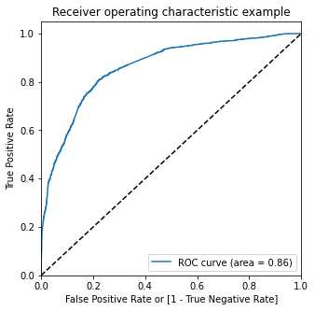
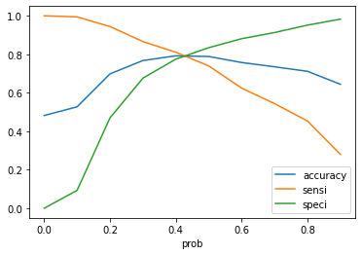
8. ROC Curve
Finding Optimal Cut off Point
Optimal cut off probability is that probability where we get balanced sensitivity and specificity.
From the second graph it is visible that the optimal cut off is approximately at 0.35.

Slide 14
9. Conclusion & Recommendation
It was found out that the variables that mattered the most in the potential buyers are :
The Total Time Spent on Website.
Total number of Visits.
When The Lead source was :a. Olarkchatb. WellingakWebsite
When the Last Activity was :a. SMSb. OlarkChat Conversation
When the lead origin is Lead add Form.
When the current occupation was :a. Working Professionalsb. Studentc. Unemployedd. Other
Keeping The above mentioned points in mind the X education can increase all thepotential buyers to change their mind and buy their courses.

